Slide 1
Figure Drawing and Illustration
Lesson 3 – Print Illustration

Slide 2
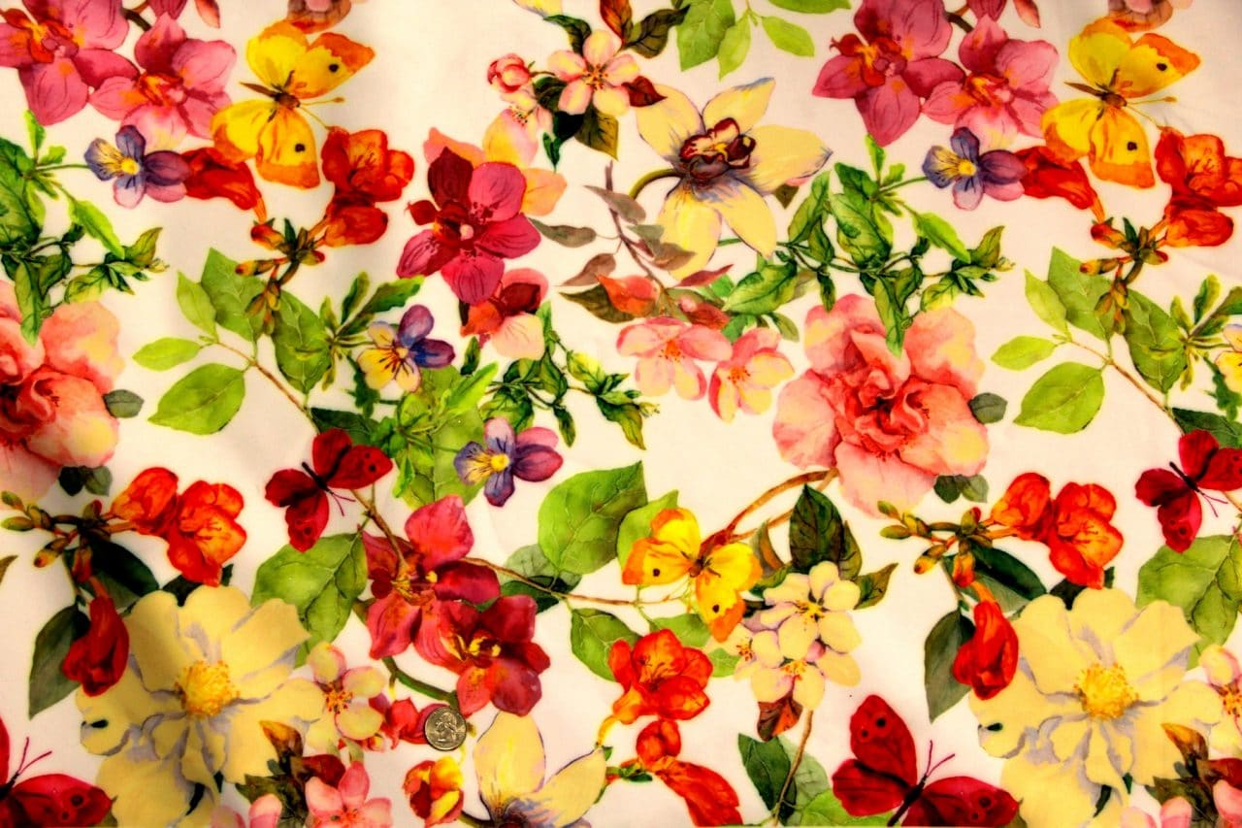
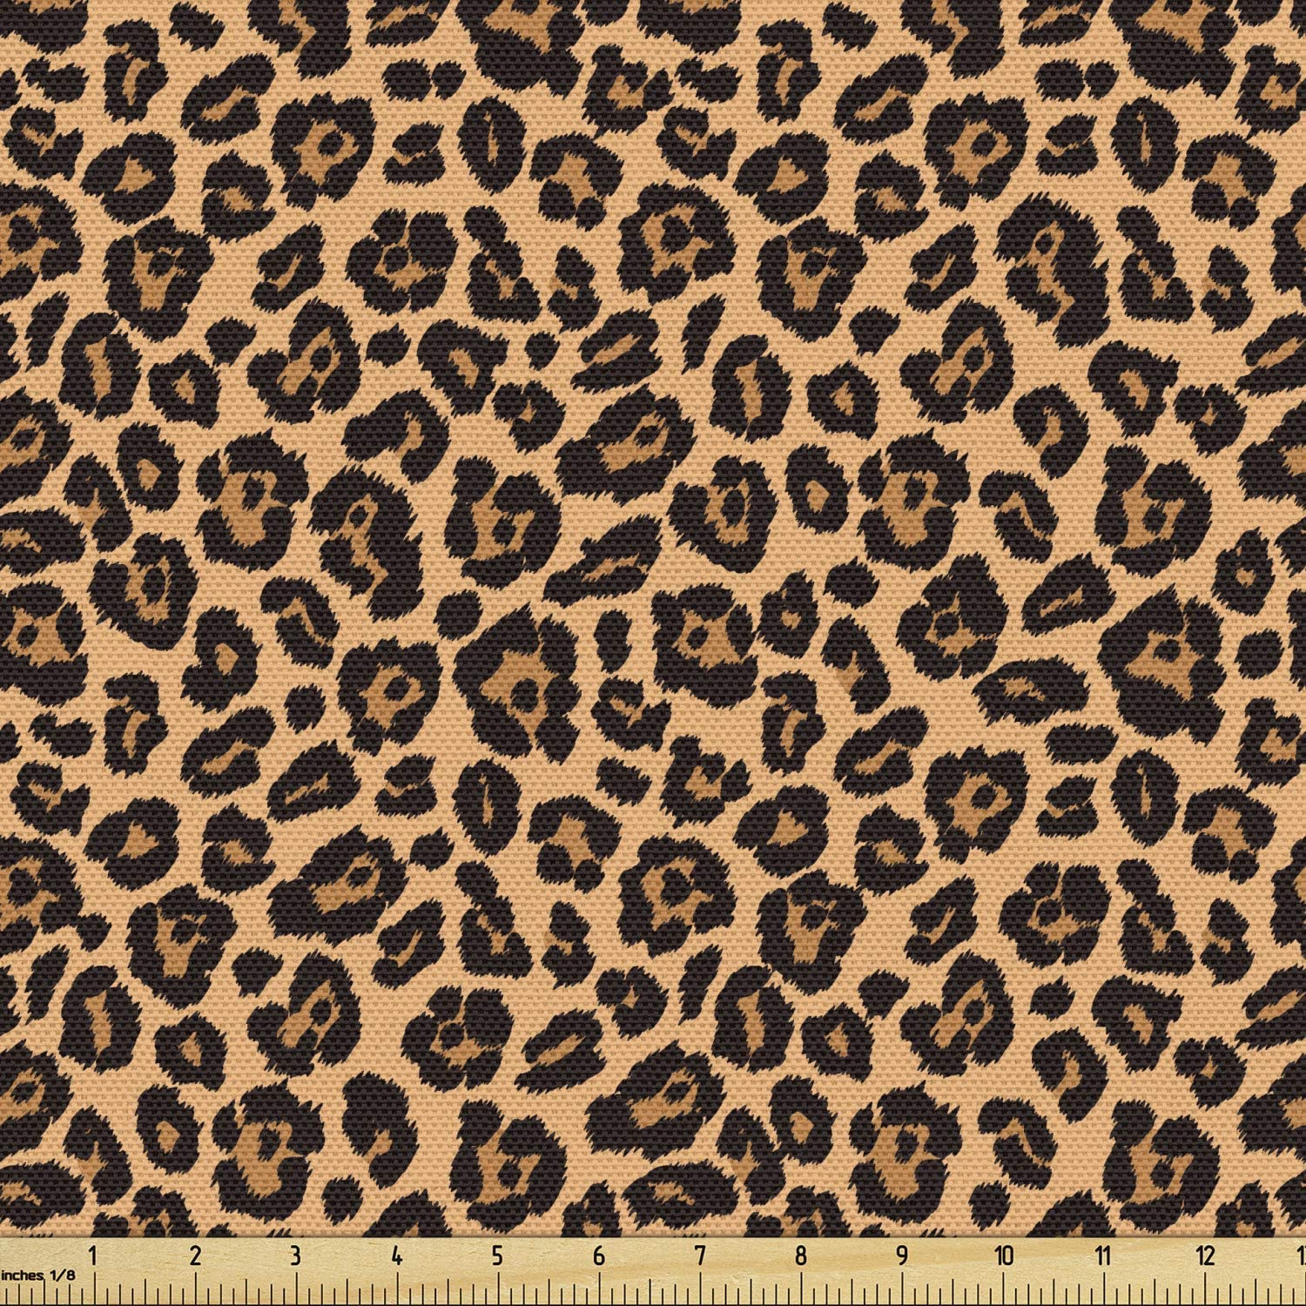

Prints – What are they?
When most people think of prints they think of a paper after it’s gone through the printer
That’s not quite what a print is in the fashion industry
The print is the design on the piece of fabric
All of the fabric examples on this slide are printed fabrics

Slide 3
Drawing Prints
Drawing a print is not easy as they are often repetitive patterns with small details.
Like everything else, they take lots of practice to get right.

Slide 4
Common Prints
Common prints include things like:
Plaid
Paisley
Florals
Stripes
Checkered

Slide 5
Why Draw the print?
Many people ask this, why draw the print? After all you know what it should look like in your head.
This is fine, if you’re working alone and have good memory.
But most designers work in big companies, and don’t actually print or sew the fabrics themselves, so it’s important that the people who are can see what the idea was.

Slide 6
How to start
When you first start drawing prints, start with simple patterns
Try stripes or checkerboard. Don’t jump right into complex designs if you’re not ready for them.

Slide 7
Tips and Tricks
One tip I can give is to take a small square of paper and draw your pattern on it, then lay in under your design with a strong light behind it
Trace the pattern from the square piece of paper and then more it over to the next blank space on the design and trace again, so that the pattern continues to repeat.

Slide 8
Practice – Assignment 1-3
Assignment 1-3 will have you practicing your patterns
Either use last weeks designs or create new ones and add prints. If you feel you’re ready for more complex prints, go ahead and try them.’
See assignment 1-3 paper for more details

